Slide 1
CGB1221-DATABASE MANAGEMENT SYSTEMS
Department of Artificial Intelligence and Data Science
Academic Year: 2024 – 2025
Register Number : 2303811724321101
Name : SHAHUL HAMEED M
Year : II
Semester : IV
Section : B
Date : 04.06.2025

Slide 2
Title of the Project
DIGITAL WALLET SYSTEM

Slide 3
Problem Identification
Traditional wallets are prone to loss, theft, or damage.
Manual tracking of transactions is time-consuming and error-prone.
Lack of centralized digital ID management for secure transactions.
Need for a secure, user-friendly digital wallet system.

Slide 4
Objective
Develop a secure digital wallet system using Flask and SQLite.
Enable users to add, spend, and transfer funds seamlessly.
Integrate digital ID verification for secure transactions.
Provide a web interface for balance and transaction management.
Ensure scalability for future payment gateway integrations.

Slide 5
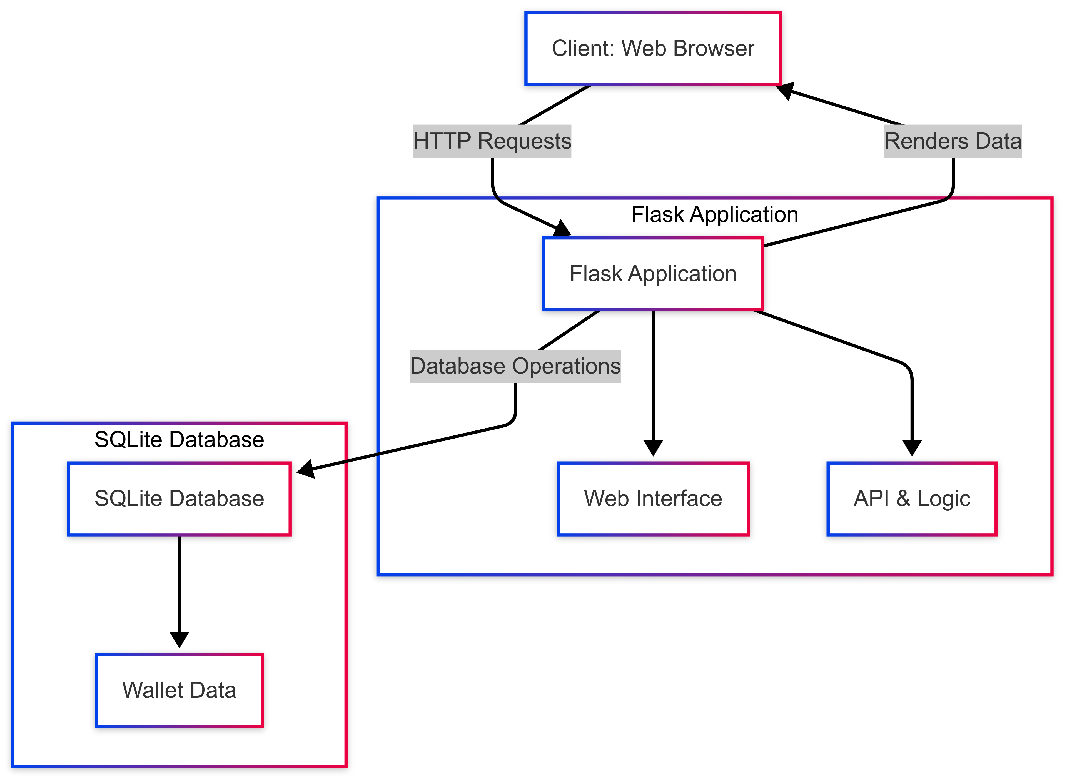
Proposed Architecture

Slide 6
List of Modules
Database Module
Balance Management Module
Transaction Management Module
Digital ID Module
API Module

Slide 7
Module Description
Database Module
Implements SQLite to manage persistent storage.
Stores data in structured tables: balance, transactions, digital IDs.
Ensures data consistency and quick retrieval for all operations.

Slide 8
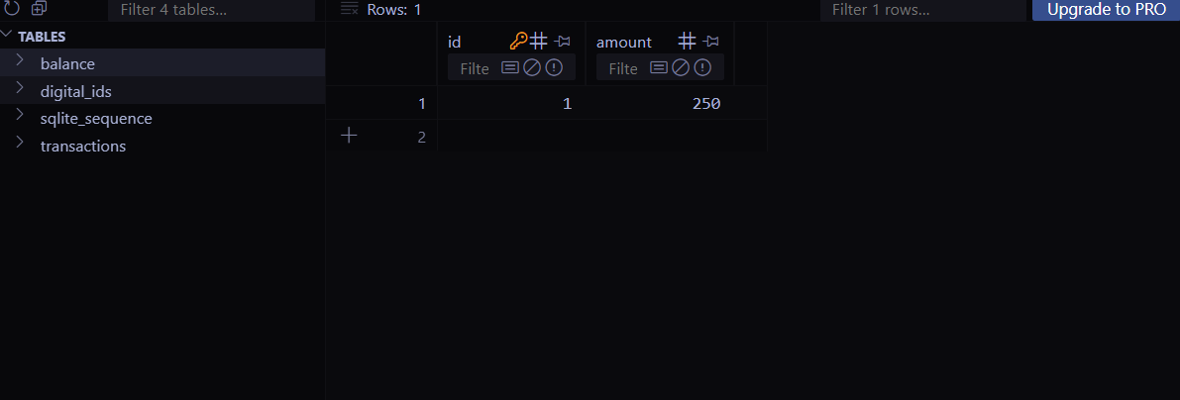
Admin dashboard

Slide 9
Module Description (Cont..)
Balance Management Module
Handles wallet balance for each user.
Updates balance on add, spend, or transfer actions.
Prevents transactions if balance is insufficient.

Slide 10
Module Description (Cont..)
Transaction Management Module
Records every credit, debit, and transfer.
Saves transaction details: amount, date, type, and description.
Ensures traceability and transparency of financial activities.

Slide 11
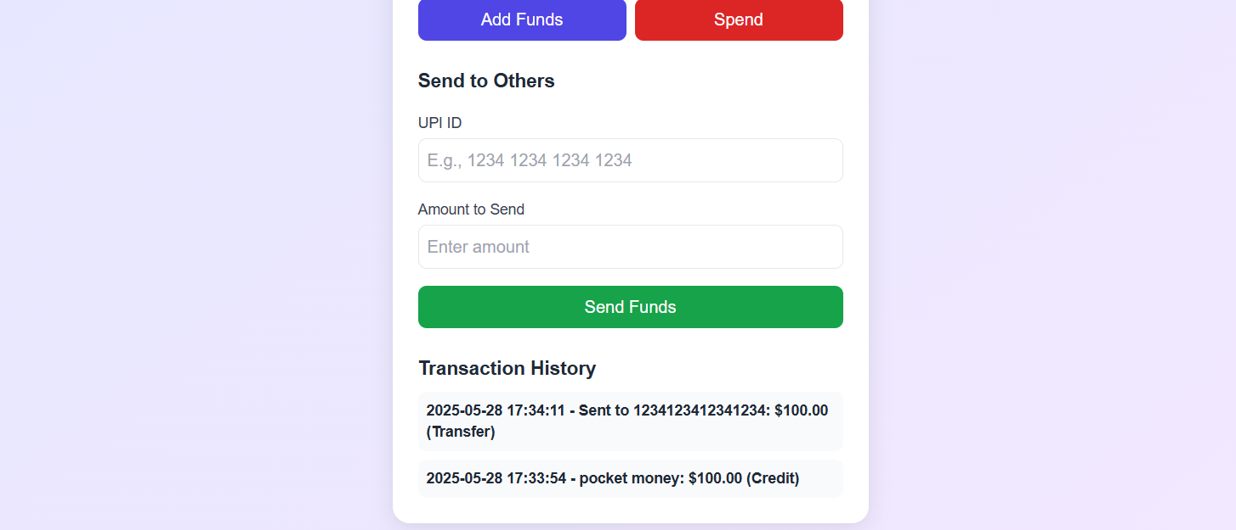
Module Description (Cont..)

Slide 12
Module Description (Cont..)
Digital ID Module
Stores and manages user digital ID information.
Verifies digital ID before allowing sensitive transactions.
Adds an extra layer of authentication for security.

Slide 13
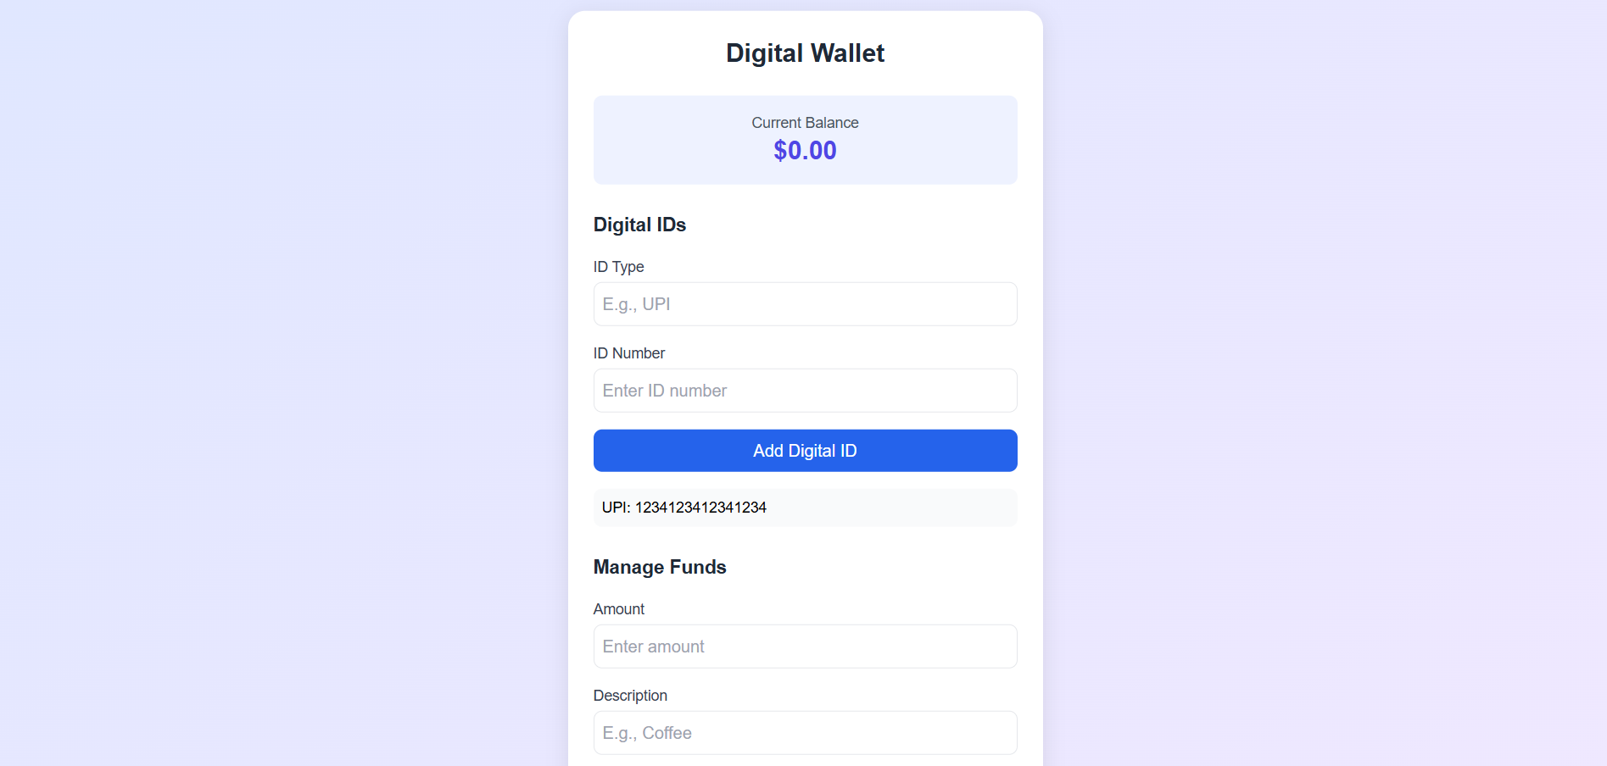
Module Description (Cont..)

Slide 14
Module Description (Cont..)
API Module
Exposes Flask-based RESTful endpoints.
Handles requests for balance, transactions, and ID data.
Supports integration with future systems or mobile apps.

Slide 15
Results

Slide 16
Conclusion
Conclusion:
Developed a secure and efficient digital wallet system using Flask and SQLite.
Enabled users to add, spend, and transfer funds seamlessly.
Integrated digital ID verification to enhance transaction security.
Future Enhancements:
Integration with Real Payment Gateways: Add support for UPI, PayPal, etc.
Enhanced Security: Implement multi-factor authentication (MFA).

Slide 17
Thank You
Any queries???

